Slide 1
Investing & The Stock Market
Stocks, Bonds, & other financial assets

Slide 2
Investment Basics
Investment: The use of current assets to earn income or profit in the future.
People make investments based on Risk Vs. Reward.
When people have a collection of financial assets, it is their personal portfolio.
The ultimate goal of investment is to generate a high rate of return on your investment, meaning you made an amount of money above the amount you initially invested.

Slide 3
How do we invest?
A Financial System is the network that allows the transfer of money between savers and borrowers.
The ”middle-man” that help transfer the money between savers and borrowers are called Financial Intermediaries.

Slide 4


Various types of investment
Bonds
Certificates of Deposit (CD’s)
Money Market Mutual Funds
Hedge Funds
Stocks

Slide 5


Bonds
Bonds are basically loans, or IOU’s, that represent debt a seller must pay back to an investor.
Components of a Bond:
Coupon Rate: the interest rate the seller will pay to the bondholder.
Maturity: the length of time until the bond will be repaid.
Per Value: the amount to be paid to the bondholder once it reaches maturity.

Slide 6
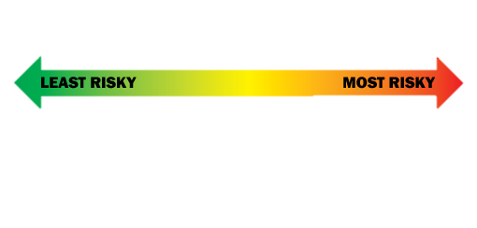
Types of Bonds
Savings Bonds: Low-denomination ($50-$10,000) bonds issued by the U.S. government.
Treasury Bonds, T-Notes, and T-Bills: Bonds issued by the U.S. Treasury Department, backed by the “Full Faith & Credit” of the U.S. Government.
  T-Bonds: Long term (30 years)
  T-Notes: Intermediate term (2,5, or 10 years)
  T-Bills: Short term (1 year or less)
Municipal Bonds: State & local government issued bonds to finance local projects.
Corporate Bonds: Bonds issued by businesses to help raise money & grow.
Junk Bonds: High risk, non-investment grade bond issued by a company.

Slide 7
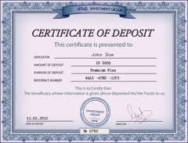
CD’s and Money market mutual funds
Certificates of Deposit (CD’s): Investments into a bank for a set amount of time. Requires a small amount of money and pays a better interest rate than a common savings account.
Money Market Mutual Funds: Financial Intermediaries collect money from investors and then buy a variety of stocks, bonds, & other financial assets on their behalf.
Hedge Fund: Similar to a Mutual Fund, but privately owned and a little more aggressive in strategy.

Slide 8
Stocks
When you buy stock, you buy shares. Which tell you that you have purchased ownership in the company.
Businesses sell stock to raise revenue and expand their business.
People buy stock to make money in one of two ways:
Dividends: A business paying out a portion of their profits to their shareholders.
Capital Gains: Selling their stock at a higher price than they purchased it.
  If a stockholder sells for a price lower than they bought, it is called Capital Loss.

Slide 9
How do we invest in stocks?
For a common person to invest, they go through a brokerage firm.
Brokerage firms and the stockbrokers that represent them act as the middle-man between investors and companies (buyers and sellers).
The market for buying and selling of stocks is known as a Stock Exchange.

Slide 10
Types of stocks
Income Stock: A stock that pays dividends as a means of paying investors.
Growth Stock: A stock that does not pay dividends, but rather reinvests profit into the company so that it grows over time.
Common Stock: Investors in this type of stock receive votes on company ownership; one vote per share owned.
Preferred Stock: Owners of preferred stock receive dividends before the owners of common stock. If the company goes out of business, preferred stock owners get their investments back before common stockholders.

Slide 11
Interpreting the health of the market
When the stock market is experiencing steady growth for a period of time it is called a Bull Market.
However when stock prices experience a steady fall for a period of time it is referred to as a Bear Market.

Slide 12
The man, the myth, the legend
-Warren Buffet: On investing
Notes:
Warren Buffett talking about basic investment tips…

Slide 13
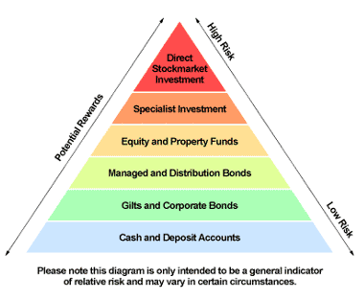
Risk Vs. Reward on various types of investment

